Slide 1
XML eXtensible Markup Language
Basic XML Concepts
Defining XML Data Formats

Slide 2
XML is not…
A replacement for HTML
(but HTML can be generated from XML)
A presentation format
(but XML can be converted into one)
A programming language
(but it can be used with almost any language)
A network transfer protocol
(but XML may be transferred over a network)
A database
(but XML may be stored into a database)

Slide 3
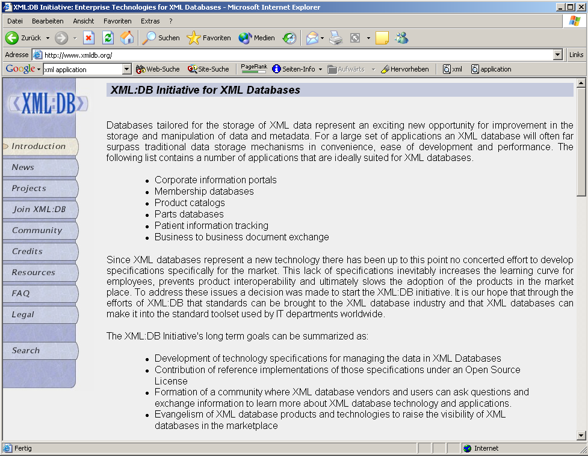



App. Scenario 1: Content Mgt.
Clients
XML2HTML
XML2WML
XML2PDF
Converters
Database with XML documents

Slide 4
XML
Basic XML Concepts
2.1 XML Standards by the W3C
2.2 XML Documents
2.3 Namespaces

Slide 5
2.2 XML Documents
What‘s in an XML document?
Elements
Attributes
plus some other details

Slide 6
A Simple XML Document
<article>
<author>Gerhard Weikum</author>
<title>The Web in Ten Years</title>
<text>
<abstract>In order to evolve...</abstract>
<section number=“1” title=“Introduction”>
The <index>Web</index> provides the universal...
</section>
</text>
</article>

Slide 7
A Simple XML Document
<article>
<author>Gerhard Weikum</author>
<title>The Web in Ten Years</title>
<text>
<abstract>In order to evolve...</abstract>
<section number=“1” title=“Introduction”>
The <index>Web</index> provides the universal...
</section>
</text>
</article>
Freely definable tags

Slide 8
A Simple XML Document
Start Tag
<article>
<author>Gerhard Weikum</author>
<title>The Web in Ten Years</title>
<text>
<abstract>In order to evolve...</abstract>
<section number=“1” title=“Introduction”>
The <index>Web</index> provides the universal...
</section>
</text>
</article>
Content of the Element (Subelements and/or Text)
End Tag
Element

Slide 9
A Simple XML Document
<article>
<author>Gerhard Weikum</author>
<title>The Web in Ten Years</title>
<text>
<abstract>In order to evolve...</abstract>
<section number=“1” title=“Introduction”>
The <index>Web</index> provides the universal...
</section>
</text>
</article>
Attributes with name and value

Slide 10
Elements in XML Documents
(Freely definable) tags: article, title, author
  with start tag: <article> etc.
  and end tag: </article> etc.
Elements: <article> ... </article>
Elements have a name (article) and a content (...)
Elements may be nested.
Elements may be empty: <this_is_empty/>
Element content is typically parsed character data (PCDATA), i.e., strings with special characters, and/or nested elements (mixed content if both).
Each XML document has exactly one root element and forms a tree.
Elements with a common parent are ordered.

Slide 11
Elements vs. Attributes
Elements may have attributes (in the start tag) that have a name and
a value, e.g. <section number=“1“>.
What is the difference between elements and attributes?
Only one attribute with a given name per element (but an arbitrary number of subelements)
Attributes have no structure, simply strings (while elements can have subelements)
As a rule of thumb:
Content into elements
Metadata into attributes
Example:
<person born=“1912-06-23“ died=“1954-06-07“>
Alan Turing</person> proved that…

Slide 12
XML Documents as Ordered Trees
article
author
title
text
number=“1“
abstract
section
Gerhard Weikum
title=“…“
In order …
The
index
provides …
The Web in 10 years
Web

Slide 13
More on XML Syntax
Some special characters must be escaped using entities:
< → &lt;
& → &amp;
(will be converted back when reading the XML doc)
Some other characters may be escaped, too:
> → &gt;
“ → &quot;
‘ → &apos;

Slide 14
Well-Formed XML Documents
A well-formed document must adher to, among others, the following rules:
Every start tag has a matching end tag.
Elements may nest, but must not overlap.
There must be exactly one root element.
Attribute values must be quoted.
An element may not have two attributes with the same name.
Comments and processing instructions may not appear inside tags.
No unescaped < or & signs may occur inside character data.

Slide 15
Well-Formed XML Documents
A well-formed document must adher to, among others, the following rules:
Every start tag has a matching end tag.
Elements may nest, but must not overlap.
There must be exactly one root element.
Attribute values must be quoted.
An element may not have to attributes with the same name.
Comments and processing instructions may not appear inside tags.
No unescaped < or & signs may occur inside character data.
Only well-formed documents can be processed by XML parsers.

Slide 16
2.3 Namespaces
<library>
<description>Library of the CS Department</description>
<book bid=“HandMS2000“>
<title>Principles of Data Mining</title>
<description>
Short introduction to <em>data mining</em>, useful
for the IRDM course
</description>
</book>
</library>
Semantics of the description element is ambigous
Content may be defined differently
Renaming may be impossible (standards!)
⇒ Disambiguation of separate XML applications using unique prefixes

Slide 17
Namespace Syntax
<dbs:book xmlns:dbs=“http://www-dbs/dbs“>
Prefix as abbrevation of URI
Unique URI to identify the namespace
Signal that namespace definition happens

Slide 18
Namespace Example
<dbs:book xmlns:dbs=“http://www-dbs/dbs“>
<dbs:description> ... </dbs:description>
<dbs:text>
<dbs:formula>
<mathml:math xmlns:mathml=“http://www.w3.org/1998/Math/MathML“>
...
</mathml:math>
</dbs:formula>
</dbs:text>
</dbs:book>

Slide 19
XML
Defining XML Data Formats
3.1 Document Type Definitions
3.2 XML Schema (very short)

Slide 20
3.1 Document Type Definitions
Sometimes XML is too flexible:
Most Programs can only process a subset of all possible XML applications
For exchanging data, the format (i.e., elements, attributes and their semantics) must be fixed
Document Type Definitions (DTD) for establishing the vocabulary for one XML application (in some sense comparable to schemas in databases)
A document is valid with respect to a DTD if it conforms to the rules specified in that DTD.
Most XML parsers can be configured to validate.

Slide 21
DTD Example: Elements
<!ELEMENT article (title,author+,text)>
<!ELEMENT title (#PCDATA)>
<!ELEMENT author (#PCDATA)>
<!ELEMENT text (abstract,section*,literature?)>
<!ELEMENT abstract (#PCDATA)>
<!ELEMENT section (#PCDATA|index)+>
<!ELEMENT literature (#PCDATA)>
<!ELEMENT index (#PCDATA)>
Content of the text element may contain zero or more section elements in this position
Content of the title element is parsed character data
Content of the article element is a title element, followed by one or more author elements,
followed by a text element

Slide 22
Element Declarations in DTDs
One element declaration for each element type:
<!ELEMENT element_name content_specification>
where content_specification can be
(#PCDATA) parsed character data
(child) one child element
(c1,…,cn) a sequence of child elements c1…cn
(c1|…|cn) one of the elements c1…cn
For each component c, possible counts can be specified:
  c exactly one such element
  c+ one or more
  c* zero or more
  c? zero or one

Slide 23
Attribute Declarations in DTDs
Attributes are declared per element:
<!ATTLIST section number CDATA #REQUIRED
title CDATA #REQUIRED>
declares two required attributes for element section.
element name
attribute name
attribute type
attribute default

Slide 24
Attribute Declarations in DTDs
Attributes are declared per element:
<!ATTLIST section number CDATA #REQUIRED
title CDATA #REQUIRED>
declares two required attributes for element section.
Possible attribute defaults:
#REQUIRED is required in each element instance
#IMPLIED is optional
#FIXED default always has this default value
default has this default value if the attribute is
omitted from the element instance

Slide 25
Attribute Types in DTDs
CDATA string data
(A1|…|An) enumeration of all possible values of the
attribute (each is XML name)
ID unique XML name to identify the element
IDREF refers to ID attribute of some other element
(„intra-document link“)
IDREFS list of IDREF, separated by white space
plus some more

Slide 26
Attribute Examples
<ATTLIST publication type (journal|inproceedings) #REQUIRED
pubid ID #REQUIRED>
<ATTLIST cite cid IDREF #REQUIRED>
<ATTLIST citation ref IDREF #IMPLIED
cid ID #REQUIRED>
<publications>
<publication type=“journal“ pubid=“Weikum01“>
<author>Gerhard Weikum</author>
<text>In the Web of 2010, XML <cite cid=„12“/>...</text>
<citation cid=„12“ ref=„XML98“/>
<citation cid=„15“>...</citation>
</publication>
<publication type=“inproceedings“ pubid=“XML98“>
<text>XML, the extended Markup Language, ...</text>
</publication>
</publications>

Slide 27
Attribute Examples
<ATTLIST publication type (journal|inproceedings) #REQUIRED
pubid ID #REQUIRED>
<ATTLIST cite cid IDREF #REQUIRED>
<ATTLIST citation ref IDREF #IMPLIED
cid ID #REQUIRED>
<publications>
<publication type=“journal“ pubid=“Weikum01“>
<author>Gerhard Weikum</author>
<text>In the Web of 2010, XML <cite cid=„12“/>...</text>
<citation cid=„12“ ref=„XML98“/>
<citation cid=„15“>...</citation>
</publication>
<publication type=“inproceedings“ pubid=“XML98“>
<text>XML, the extended Markup Language, ...</text>
</publication>
</publications>

Slide 28
Connecting a Document with its DTD
Connecting a Document with its DTD
➢An internal DTD
<?xml version="1.0"?>
<!DOCTYPE db [<!ELEMENT ...> … ]>
<db> ... </db>
➢A DTD from the local file system:
<!DOCTYPE db SYSTEM "schema.dtd">
➢A DTD from a remote file system:
<!DOCTYPE db SYSTEM "http://www.schemaauthority.com/schema.dtd">

Slide 29
Linking DTD and XML Docs
Internal DTD:
  <?xml version=“1.0“?>
  <!DOCTYPE article [
  <!ELEMENT article (title,author+,text)>
  ...
  <!ELEMENT index (#PCDATA)>
  ]>
  <article>
  ...
  </article>
Both ways can be mixed, internal DTD overwrites external entity information:
  <!DOCTYPE article SYSTEM „article.dtd“ [
  <!ENTITY % pub_content (title+,author*,text)
  ]>

Slide 30
Flaws of DTDs
No support for basic data types like integers, doubles, dates, times, …
No structured, self-definable data types
No type derivation
id/idref links are quite loose (target is not specified)
⇒ XML Schema

Slide 31
3.2 XML Schema Basics
XML Schema is an XML application
Provides simple types (string, integer, dateTime, duration, language, …)
Allows defining possible values for elements
Allows defining types derived from existing types
Allows defining complex types
Allows posing constraints on the occurrence of elements
Allows forcing uniqueness and foreign keys
Way too complex to cover in an introductory talk

Slide 32
Simplified XML Schema Example
<xs:schema>
<xs:element name=“article“>
<xs:complexType>
<xs:sequence>
<xs:element name=“author“ type=“xs:string“/>
<xs:element name=“title“ type=“xs:string“/>
<xs:element name=“text“>
<xs:complexType>
<xs:sequence>
<xs:element name=“abstract“ type=“xs:string“/>
<xs:element name=“section“ type=“xs:string“
minOccurs=“0“ maxOccurs=“unbounded“/>
</xs:sequence>
</xs:complexType>
</xs:element>
</xs:sequence>
</xs:complexType>
</xs:element>
</xs:schema>

Slide 33
4.1 XPath
XPath is a simple language to identify parts of the XML document (for further processing)
XPath operates on the tree representation of the document
Result of an XPath expression is a set of elements or attributes
Discuss abbreviated version of XPath

Slide 34
Elements of XPath
An XPath expression usually is a location path that consists of location steps, separated by /:
  /article/text/abstract: selects all abstract elements
A leading / always means the root element
Each location step is evaluated in the context of a node in the tree, the so-called context node
Possible location steps:
  child element x: select all child elements with name x
  Attribute @x: select all attributes with name x
  Wildcards * (any child), @* (any attribute)
  Multiple matches, separated by |: x|y|z

Slide 35
Combining Location Steps
Standard: / (context node is the result of the preceding location step)
  article/text/abstract (all the abstract nodes of articles)
Select any descendant, not only children: //
  article//index (any index element in articles)
Select the parent element: ..
Select the content node: .
The latter two are important when using predicates.

Slide 36
Predicates in Location Steps
Added with [] to the location step
Used to restricts elements that qualify as result of a location step to those that fulfil the predicate:
  a[b] elements a that have a subelement b
  a[@d] elements a that have an attribute d
  Plus conditions on content/value:
    a[b=„c“]
    A[@d>7]
    <, <=, >=, !=, …

Slide 37
XPath by Example
/literature/book/author
retrieves all book authors:
starting with the root, traverses the tree, matches element
names literature, book, author, and returns elements
<author>Suciu, Dan</author>,
<author>Abiteboul, Serge</author>, ...,
<author><firstname>Jeff</firstname>
<lastname>Ullman</lastname></author>
/literature/(book|article)/author
authors of books or articles
/literature/*/author
authors of books, articles, essays, etc.
/literature//author
authors that are descendants of literature
/literature//@year
value of the year attribute of descendants of literature
/literature//author[firstname]
authors that have a subelement firstname
/literature/book[price < „50“]
low priced books
/literature/book[author//country = „Germany“]
books with German author

